Slide 1









FAME

Slide 2



Agenda
Welcome!
Meet the Team
Kahoot Family Challenge
LIGHTS!
Beacon Results
Math Activity
Goal setting for second semester
Camera!
Beacon Growth Awards
Action!

Slide 3


Dr. Broyles
Principal
Wendy Mace
EAC
Meet the team!!
Jamye Pierce
ILC
jpierce@paulding.k12.ga.us
Regina Evans
6th grade
reginaa.evans41@paulding.k12.ga.us
Tori Martin
7th grade
tmartin@paulding.k12.ga.us

Slide 4
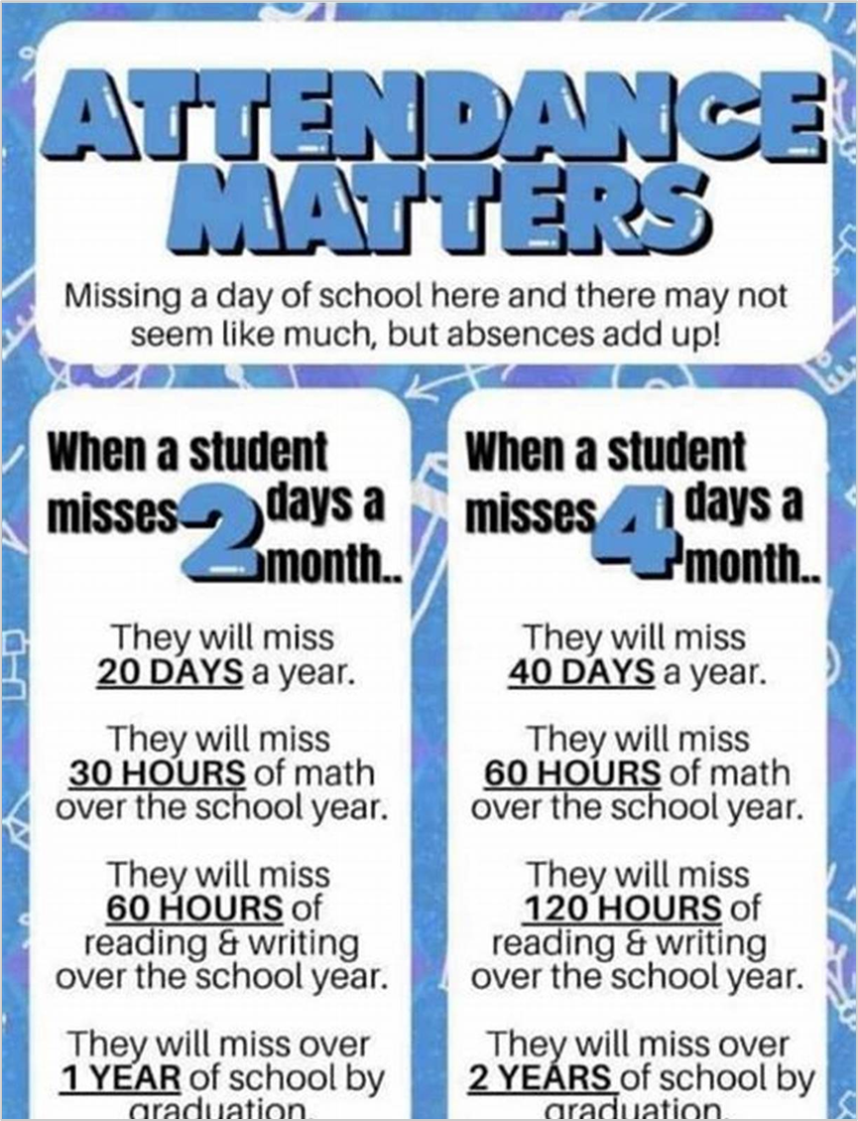
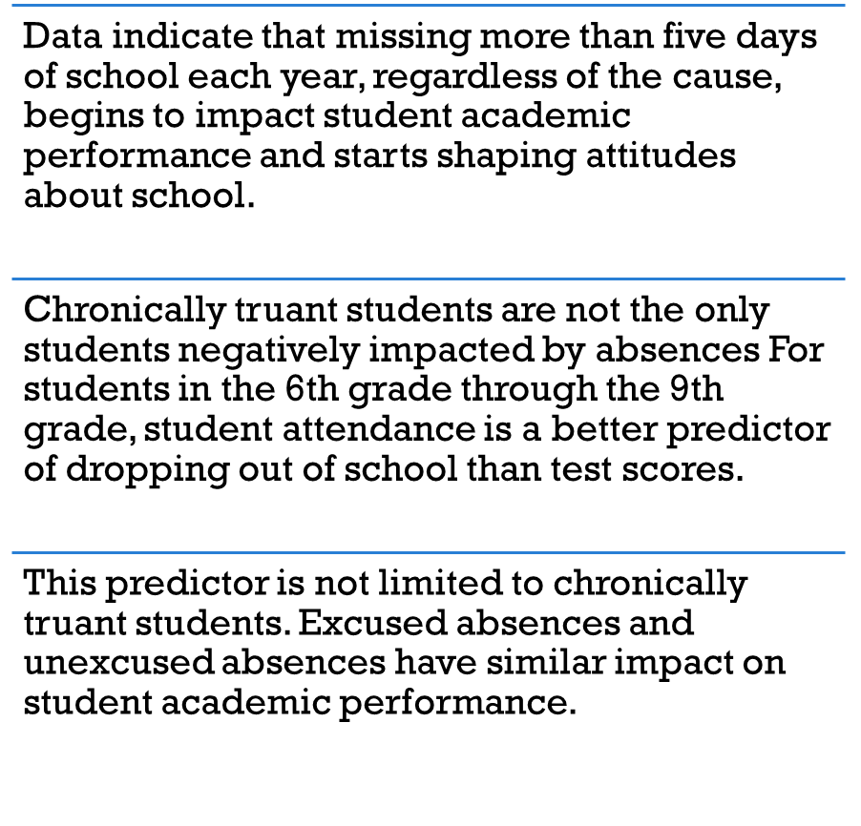

Slide 5


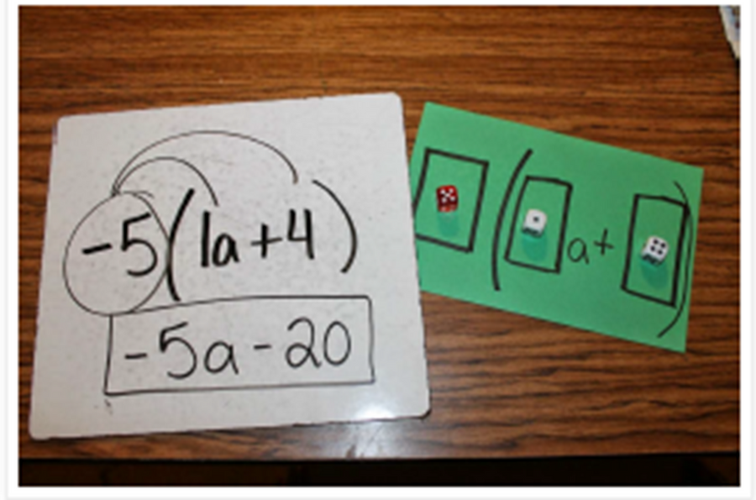
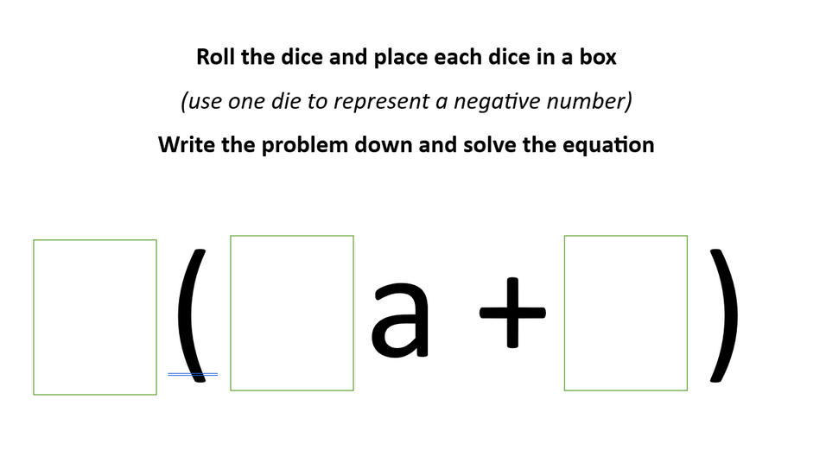
Take Home
Activity
Distributive Property

Slide 6
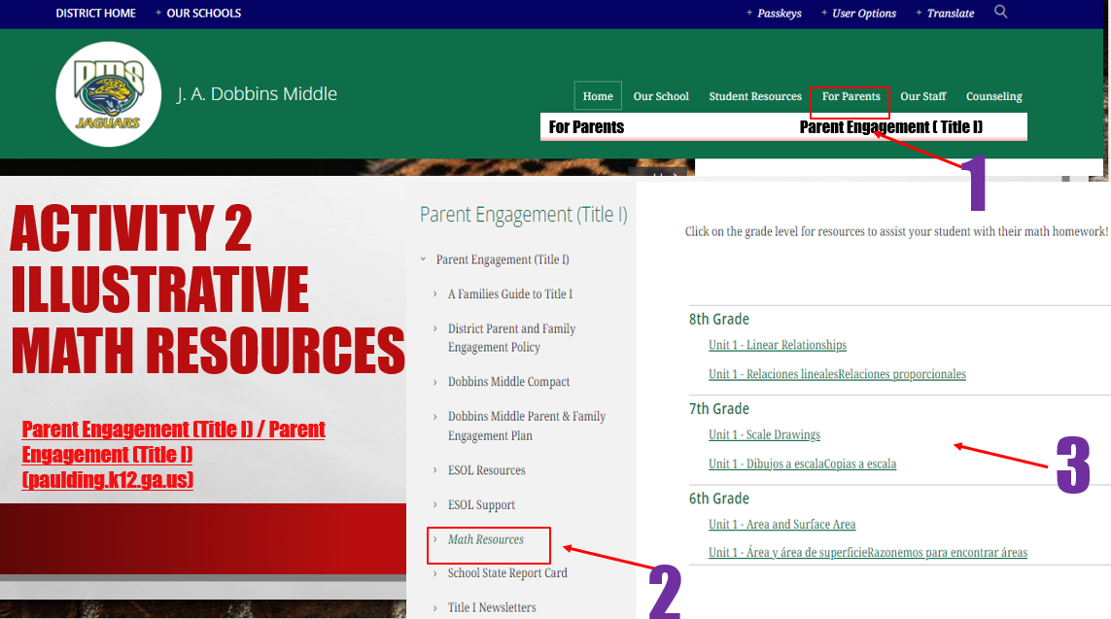
Resource
for you

Slide 7



What is the Beacon assessment?
Computer-based assessment that determines learning needs, 3x per year
Indicates areas of strength and areas of need so teachers can adjust instruction
Is predictive of end of the year performance on Georgia Milestones

Slide 8
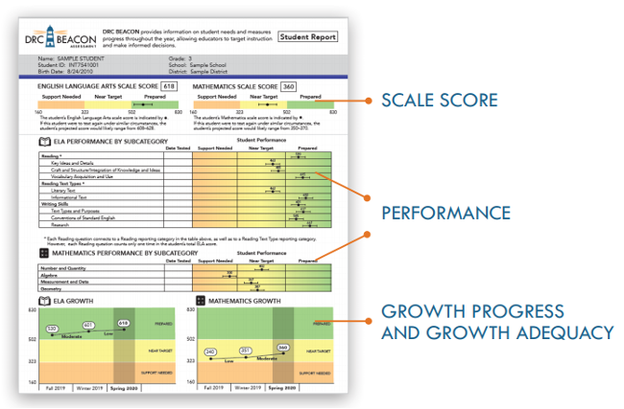

Slide 9
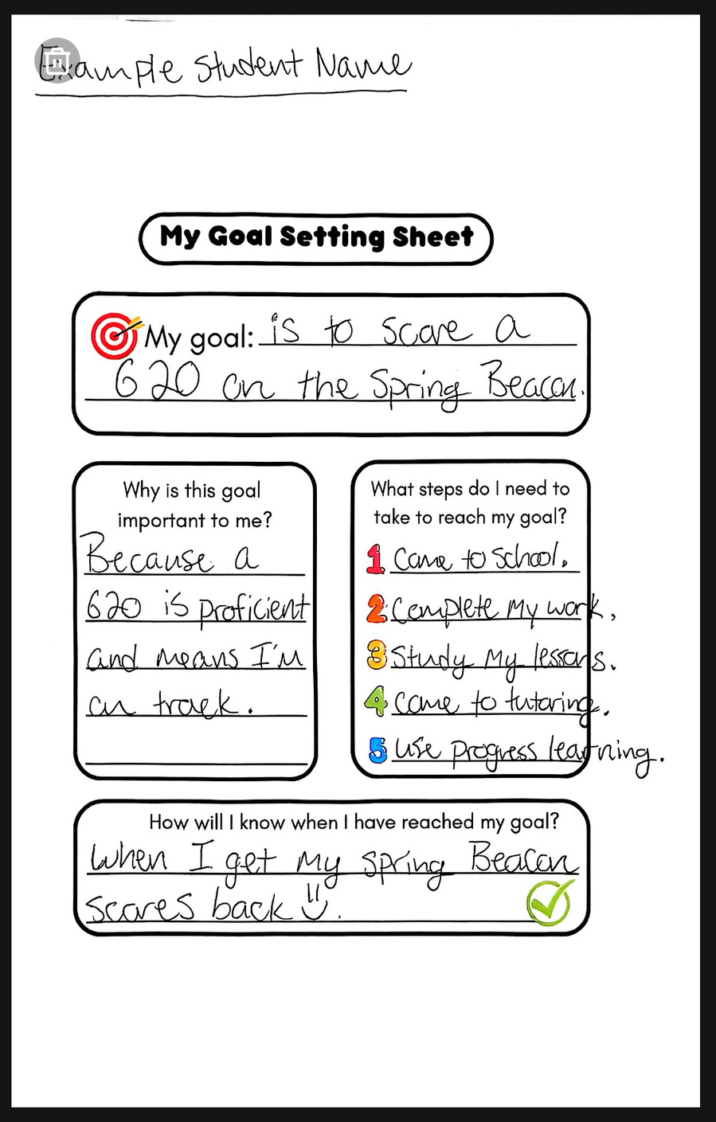

Goal Setting
  Motivation
  Sense of Ownership
  Growth Mindset
  Work Ethic
Action!

Slide 10





Congrats!
Beacon Awards

Slide 11

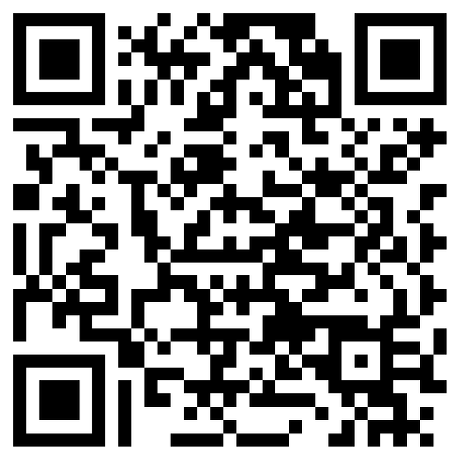
Thank you!
Please scan the code to give feedback!

